Slide 1
Large scale building damage assessment on satellite images
Md rifat ur Rahman s.M seefat alam
Id: 1806033 ID: 1806124

Slide 2
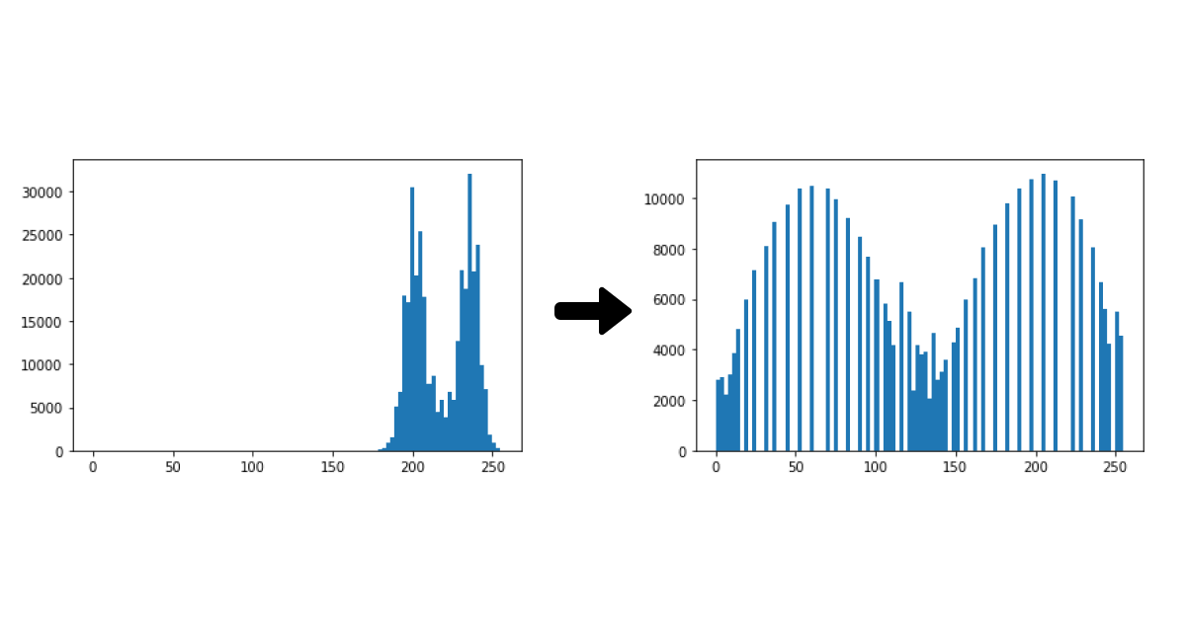
Pre-processing
CLAHE (Contrast Limited AHE)
Adaptive Histogram Equalization by tuning the clip limit. It spreads the feature domain density.

Slide 3
Pre-processing(Rescale intensity)
Rescales image intensity based on the desired range.
A range was based on the histogram plot of the image.

Slide 4
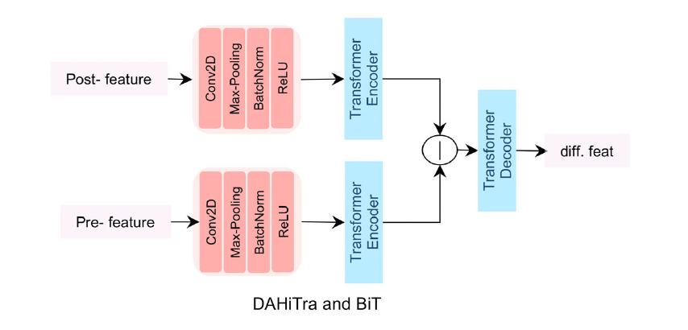
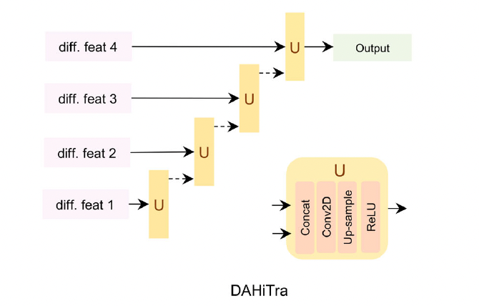
DAHiTra architecture

Slide 5
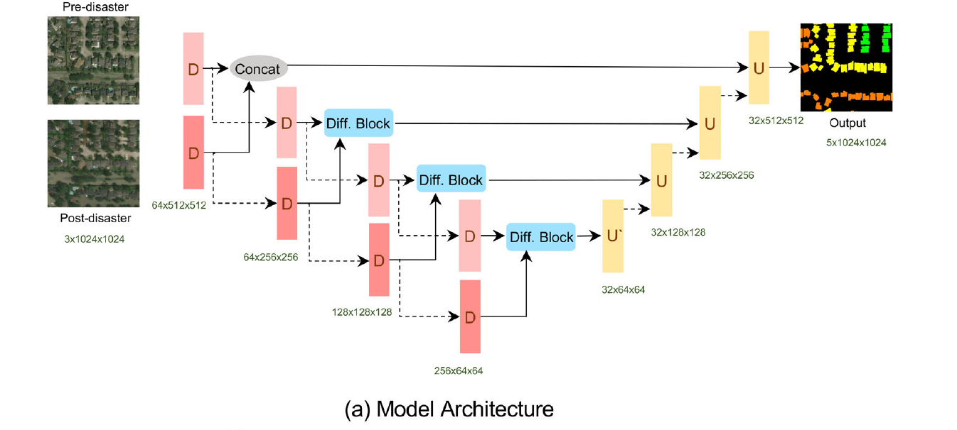

Slide 6
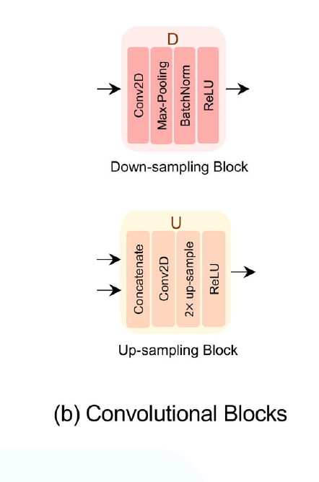
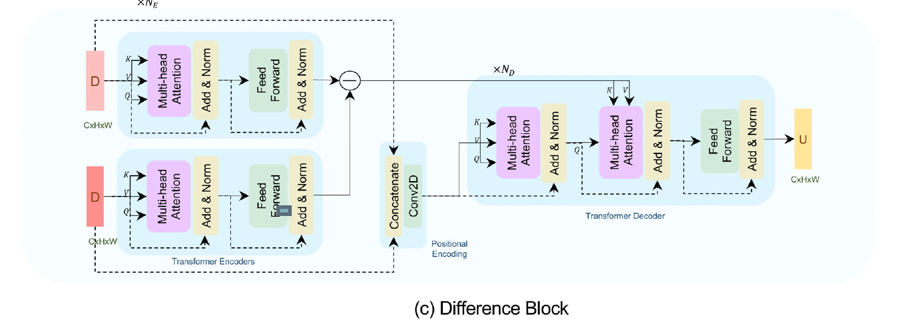

Slide 7
HOW THIS ARCHITecture works?
A pair of predisaster and postdisaster images is fed into an encoder made up of stacked convolution blocks (red layers), where each convolutional block downsamples the feature space (dashed lines).
The output from each block of pre- and postdisaster image encoders is passed jointly (solid lines) into the difference block, which maps the spatial features into the feature domain and then takes the difference followed by a transformer decoder to map the features back into the spatial domain.
Next, the output mask is hierarchically built by up-sampling (dashed lines) and concatenating the features from lower dimension to higher dimension layers.

Slide 8
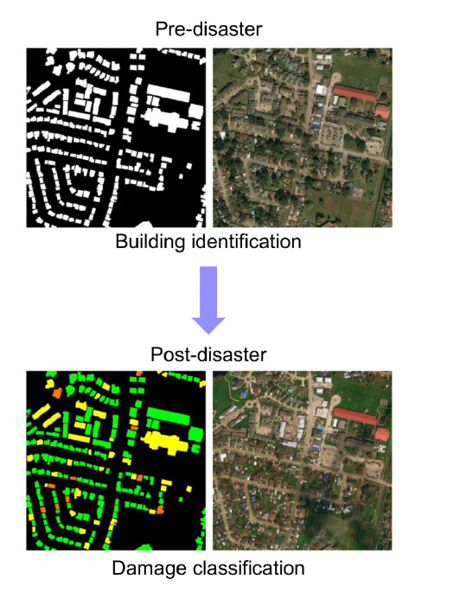
PRE disaster masking vs post disaster masking

Slide 9
Performance analysis
Model-Siam U-net | IoU | F1 score
Without Pre-processing | 0.73 | 0.76
CLAHE | 0.77 | 0.79
Rescale Intensity | 0.72 | 0.78
CLAHE+Rescale Intensity | 0.76 | 0.82

Slide 10
Performance analysis
Model-BiT | IoU | F1 score
Without Pre-processing | 0.71 | 0.74
CLAHE | 0.79 | 0.82
Rescale Intensity | 0.73 | 0.83
CLAHE+Rescale Intensity | 0.74 | 0.86

Slide 11
Thank you!

